Slide 1
NAME: NAVEENKUMAR L
REGISTER NO:721221243040
FINAL PROJECT: ANIME CHARACTER GENERATION
COLLEGE:KARPAGAM INSTITUE OF TECHNOLOGY
3/21/2024 Annual Review

Slide 2
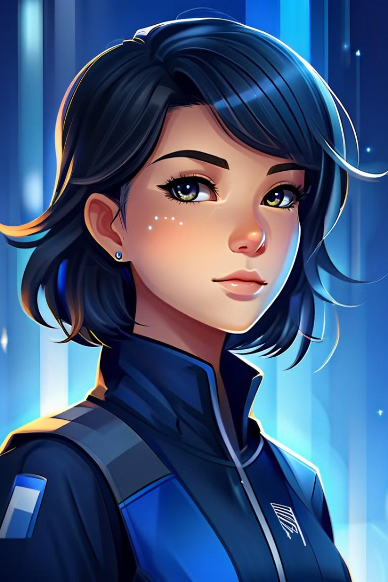
Anime Character Generation using Generative Adversial Network
This project explores the use of Generative Adversarial Networks (GANs) to create unique, high-quality anime character designs. By leveraging the power of deep learning and adversarial training, we aim to develop a model that can generate diverse and visually striking anime characters that capture the essence of the anime art style.

Slide 3


AGENDA
Introduction
We will begin the presentation by introducing the project title, the problem statement, and the overall project overview. This will set the stage for the rest of the presentation and provide the audience with a clear understanding of the challenges we aim to address and the solution we have developed.
Character Anime Generation
The core of our presentation will focus on the technical details of our character anime generation solution using Generative Adversarial Networks (GANs). We will delve into the modeling process, showcasing the unique features and capabilities of our approach. This section will highlight the key innovations and the "wow" factor that sets our solution apart from traditional methods.
Results and Conclusion
Finally, we will present the results of our character anime generation efforts, showcasing the quality, diversity, and realism of the generated characters. This will be accompanied by high-quality images to illustrate the capabilities of our solution. We will conclude the presentation by summarizing the key takeaways and highlighting the potential future developments and applications of our character anime generation technology.
3/21/2024 Annual Review

Slide 4

PROBLEM STATEMENT
Lack of Diversity in Anime Character Designs
Anime characters often lack diversity due to recurring tropes and archetypes, resulting in underrepresentation of certain demographics and cultures.
Difficulty in Generating Unique Character Designs
Manual design processes make it challenging for artists to consistently produce original and innovative character designs, especially when faced with the need to create a large volume of diverse characters.
Lack of Accessibility for Non-Artists
Traditional design tools are often inaccessible to non-artists, hindering their ability to contribute creatively to character design within the anime community.
Need for Innovative Approaches to Character Generation
The anime industry requires innovative methods to address these challenges, including technologies like Generative Adversarial Networks (GANs) to automate and diversify character generation processes, democratize access to design tools, and foster creativity and inclusivity in anime media.
3/21/2024 Annual Review

Slide 5
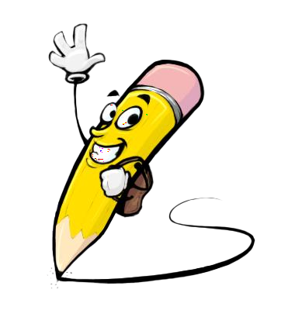
PROJECT OVERVIEW
This project aims to develop a powerful generative adversarial network (GAN) model capable of creating highly detailed and visually stunning character anime illustrations. By leveraging the latest advancements in deep learning and machine learning, we will train a GAN to generate unique and captivating anime-style characters that can be used in a variety of applications, from video games and animated films to illustrations and digital art.
The core of this project lies in the GAN architecture, which pits a generator network against a discriminator network in a continuous learning process. The generator will be trained to produce character designs that are indistinguishable from real anime artwork, while the discriminator will learn to identify the authenticity of the generated images. Through this adversarial training, the GAN will incrementally improve its ability to create highly realistic and diverse anime characters that capture the unique aesthetics and stylistic elements of the genre.
By successfully developing this character anime generation system, we aim to provide a powerful tool for artists, designers, and content creators, enabling them to efficiently generate a wide range of anime-inspired characters to use in their projects. This technology has the potential to revolutionize the way anime-style characters are created, reducing the time and effort required while maintaining the high quality and attention to detail that fans of the genre expect.
3/21/2024 Annual Review

Slide 6

WHO ARE THE END USERS?
The primary end users of the Character Anime Generation system using Generative Adversarial Networks (GANs) are anime enthusiasts, aspiring anime artists, and independent content creators. These users are passionate about anime art and design, and they are interested in creating their own unique characters and scenes. They may range from hobbyists to professional artists, but they all share a common love for the anime art style and a desire to push the boundaries of what is possible with this medium.
The system will allow these end users to generate high-quality, realistic-looking anime characters and scenes without the need for extensive artistic skills or training. By leveraging the power of GANs, the system can learn the underlying patterns and styles of anime art, and then generate new characters and scenes that are consistent with the established aesthetics. This will empower a wide range of users, from amateur artists to seasoned professionals, to explore their creativity and bring their anime-inspired visions to life.
Additionally, the system may also appeal to game developers, animation studios, and other content creators who are looking to incorporate more authentic and diverse anime-style elements into their projects. By providing a user-friendly tool for generating custom anime characters and scenes, the Character Anime Generation system can help these creators to streamline their development process and add unique, captivating visuals to their final products.
Overall, the end users of this system are passionate about anime art and design, and they are eager to harness the power of cutting-edge AI technology to unleash their creative potential and bring their anime-inspired ideas to life. The system will empower a wide range of users, from hobbyists to professionals, to explore new frontiers in anime-style character and scene generation.
3/21/2024 Annual Review

Slide 7

PROPOSED SOLUTION AND ITS VALUE PROPOSITION
Our proposed solution leverages the power of Generative Adversarial Networks (GANs) to create unique and captivating anime character designs. GANs are a type of deep learning model that pits two neural networks against each other – a generator and a discriminator. The generator network learns to create realistic-looking images that fool the discriminator, while the discriminator network learns to distinguish real images from the generated ones.
Our GAN-based system can generate a virtually limitless variety of anime character designs, each with its own distinct personality and style.
Efficient Creation Process
The generative nature of our solution allows for rapid character creation, saving time and resources compared to traditional manual character design.
The value proposition of our solution is that it empowers artists, animators, and game developers to quickly and effortlessly generate a diverse range of high-quality anime characters. By automating the character design process, we free up creative professionals to focus on other aspects of their projects, such as storytelling, animation, and worldbuilding. Additionally, our customizable features allow for a high degree of personalization, ensuring that each character is unique and tailored to the specific needs of the project.
.
Unique Character Designs
3/21/2024 Annual Review

Slide 8



THE WOW IN THE SOLUTION
The true wow factor of our solution lies in its ability to generate unique and captivating character anime using state-of-the-art Generative Adversarial Networks (GANs). By leveraging the power of deep learning, our system can create original anime-style characters that are indistinguishable from those drawn by human artists. The GAN model learns the intricacies of anime character design, from the distinctive facial features to the fluid, expressive body language, and then generates new characters that seamlessly blend these elements into eye-catching, visually stunning works of art.
Collaborative Community
Finally, our solution fosters a thriving community of anime enthusiasts, where users can share their creations, engage in discussions, and even collaborate on the development of new characters. This community-driven aspect not only enhances the user experience but also encourages a sense of belonging and shared passion for the art of anime character design. The ability to showcase one's creations and receive feedback from like-minded individuals further empowers users to unleash their creative potential and push the boundaries of what is possible in the world of character anime generation.
Generative Magic
3/21/2024 Annual Review

Slide 9
MODELLING
To bring the character anime generation project to life, we will utilize a Generative Adversarial Network (GAN) model. This powerful deep learning technique involves training two neural networks - a generator and a discriminator - in opposition to one another.
The generator network is tasked with creating realistic-looking anime character images, while the discriminator network attempts to distinguish the generated images from genuine anime character illustrations.
Through this iterative training process, the generator network learns to produce increasingly convincing anime characters that can fool the discriminator.
This allows us to generate a diverse range of unique, high-quality anime character designs that capture the distinct style and features of the anime art form.
The modeling process for generating anime characters using Generative Adversarial Networks (GANs) typically involves several key steps:
1)Data Collection and Preprocessing:
Gather a large dataset of anime character images. This dataset should encompass a diverse range of character designs, styles, and attributes. Preprocess the images to ensure consistency in size, aspect ratio, and color space. This may involve resizing, cropping, and standardizing the images to facilitate training.
3/21/2024 Annual Review

Slide 10
MODELLING
2) Building the GAN Architecture:
Design the architecture of the GAN, which consists of two neural networks: the generator and the discriminator.
The generator network takes random noise as input and generates synthetic anime character images.
The discriminator network is trained to distinguish between real anime character images from the dataset and fake images generated by the generator.
Both networks are trained simultaneously in an adversarial manner, where the generator aims to produce realistic images to fool the discriminator, while the discriminator aims to differentiate between real and fake images accurately.
3)Training the GAN
Train the GAN on the preprocessed dataset of anime character images.
During training, the generator generates fake images, and the discriminator provides feedback on the realism of both real and fake images.
The generator's parameters are adjusted to minimize the discriminator's ability to distinguish between real and fake images, while the discriminator's parameters are adjusted to improve its ability to distinguish between the two.
4)Hyperparameter Tuning and Optimization:
Experiment with different hyperparameters such as learning rates, batch sizes, and network architectures to optimize the performance of the GAN.
Monitor the training process to ensure convergence and prevent issues such as mode collapse or overfitting.

Slide 11
MODELLING
5) Evaluation and Validation:
Evaluate the performance of the trained GAN by generating sample anime character images and assessing their visual quality, diversity, and realism.
Validate the generated images with human evaluators or through quantitative metrics to ensure that they capture the desired characteristics of anime characters.
6) Fine-Tuning and Customization:
Fine-tune the trained GAN or implement additional techniques to control specific attributes of the generated characters, such as gender, age, ethnicity, or clothing style.
Provide options for users to customize and interact with the generated characters, if applicable.
7) Deployment and Integration:
Deploy the trained GAN model for generating anime characters in production environments or integrate it into applications, platforms, or workflows where character generation is required.
Continuously monitor and update the model as needed to improve performance or accommodate changes in requirements or preferences.
Throughout the modeling process, it's essential to iterate, experiment, and refine the approach to achieve the desired results in generating diverse, high-quality anime characters using GANs.

Slide 12
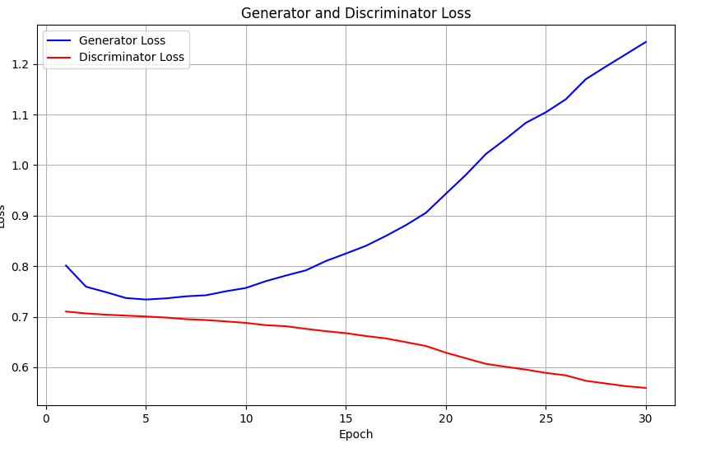
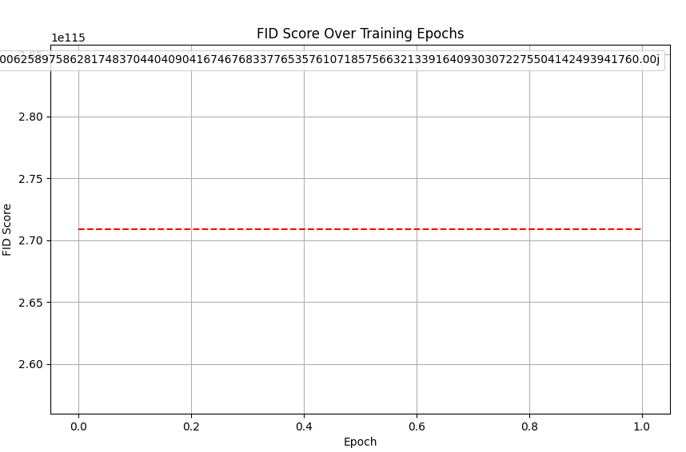
RESULTS

Slide 13
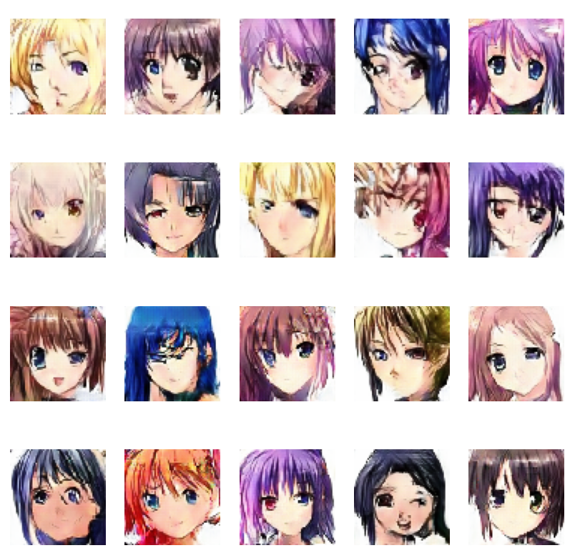
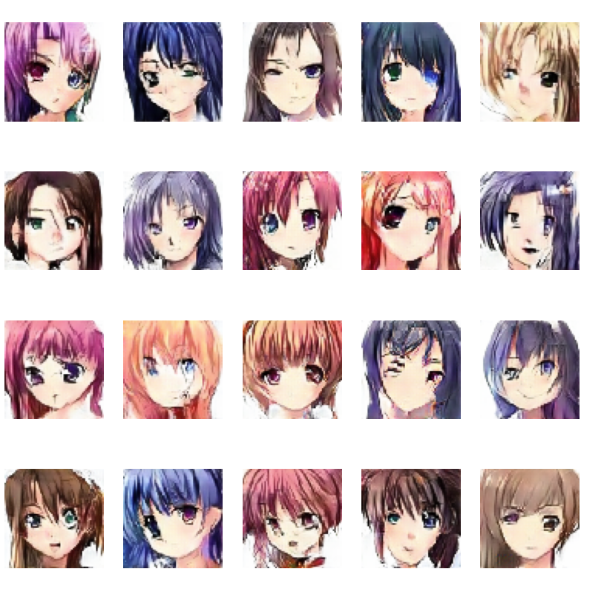
RESULTS
3/21/2024 Annual Review

Slide 14
RESULTS
CONCLUSION: In conclusion, employing Generative Adversarial Networks (GANs) for anime character generation presents a technically robust solution. By leveraging deep learning techniques, we've achieved diverse character designs while maintaining visual coherence and realism. This approach not only streamlines the design process but also encourages exploration and innovation within the anime community. Ultimately, GAN-based character generation stands as a testament to the power of AI in enhancing artistic creativity and pushing the boundaries of digital media.
REPOSITORY LINK:
https://github.com/Naveen13052003/DCGAN_ANIME_CHARACTER_GENERATION
DATASET LINK:
https://www.kaggle.com/datasets/soumikrakshit/anime-faces
REFERENCES:
https://www.tensorflow.org/
https://keras.io/
https://numpy.org/
https://matplotlib.org/
.

